Slide 1


Variables
Chris Piech
CS106A, Stanford University

Slide 2
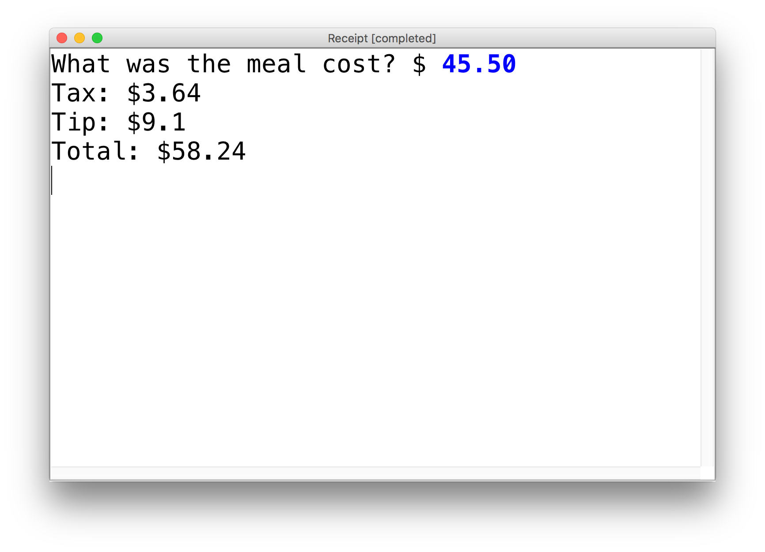
New Ability
Write a program that calculates the tax, tip and total bill for us at a restaurant.
The program should ask the user for the subtotal, and then calculate and print out the tax, tip and total.

Slide 3
Review: Decomposition
Each method solves one ”problem”
Methods should have good names
Comment each of your methods
Length of methods should be < 15 lines
Methods should ideally be generalizable
Notes:
He looks like an old machintosh machine.
Hes got legs… one sticks out the back. That’s just the way it is.

Slide 4
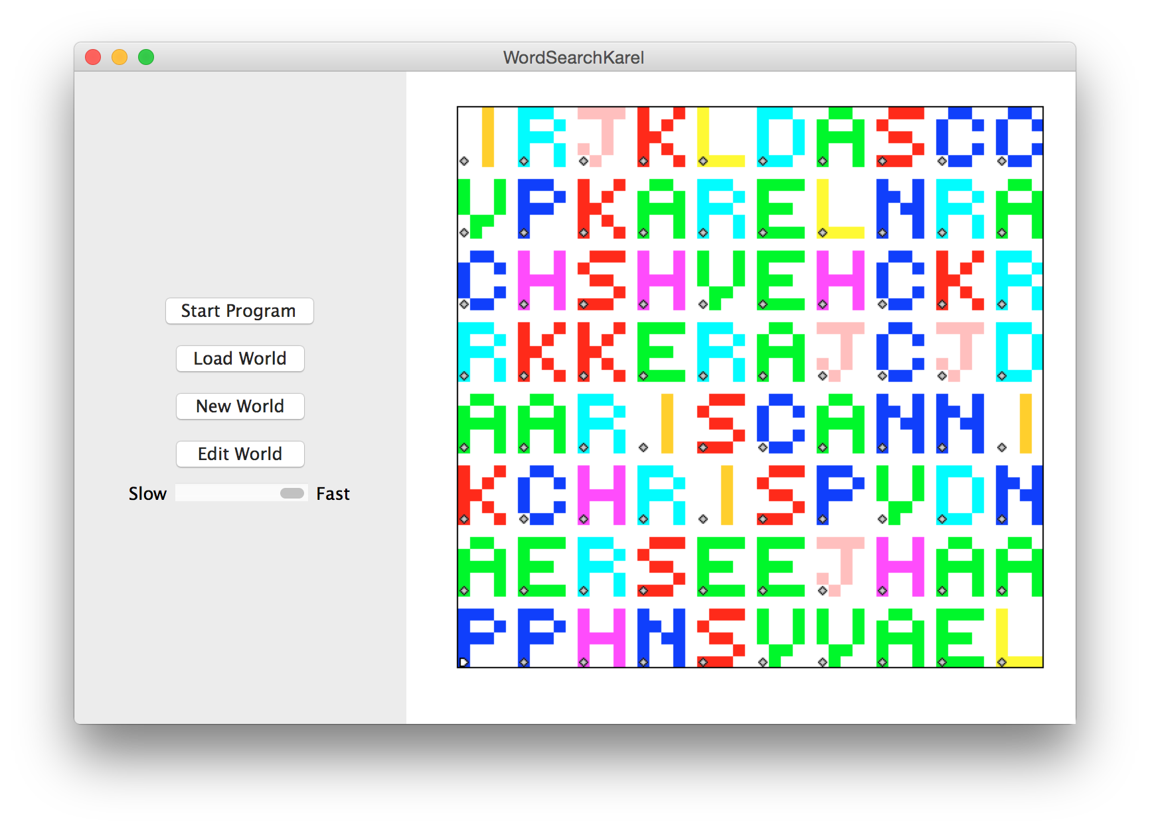

3

Slide 5
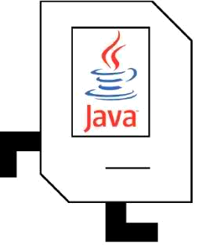
Rhoomba Karel
Write a Roomba Karel that sweeps the entire world of all beepers.
Karel starts at (1,1) facing East.
The world is rectangular, and some squares contain beepers.
There are no interior walls.
When the program is done, the world should contain 0 beepers.
Karel's ending location does not matter.
How should we approach this tricky problem?
8
.
.
.
.
.
.
.
.
7
.
.
.
.
.
.
.
.
6
.
.
.
.
.
.
.
.
5
.
.
.
.
.
.
.
.
4
.
.
.
.
.
.
.
.
3
.
.
.
.
.
.
.
.
2
.
.
.
.
.
.
.
.
1
.
.
.
.
.
.
.
.
1
2
3
4
5
6
7
8

Slide 6
Possible Algorithm 1
8
.
.
.
.
.
.
.
.
7
.
.
.
.
.
.
.
.
6
.
.
.
.
.
.
.
.
5
.
.
.
.
.
.
.
.
4
.
.
.
.
.
.
.
.
3
.
.
.
.
.
.
.
.
2
.
.
.
.
.
.
.
.
1
.
.
.
.
.
.
.
.
1
2
3
4
5
6
7
8

Slide 7
Possible Algorithm 2
8
.
.
.
.
.
.
.
.
7
.
.
.
.
.
.
.
.
6
.
.
.
.
.
.
.
.
5
.
.
.
.
.
.
.
.
4
.
.
.
.
.
.
.
.
3
.
.
.
.
.
.
.
.
2
.
.
.
.
.
.
.
.
1
.
.
.
.
.
.
.
.
1
2
3
4
5
6
7
8

Slide 8
Possible Algorithm 3
8
.
.
.
.
.
.
.
.
7
.
.
.
.
.
.
.
.
6
.
.
.
.
.
.
.
.
5
.
.
.
.
.
.
.
.
4
.
.
.
.
.
.
.
.
3
.
.
.
.
.
.
.
.
2
.
.
.
.
.
.
.
.
1
.
.
.
.
.
.
.
.
1
2
3
4
5
6
7
8

Slide 9
Possible Algorithm 4
8
.
.
.
.
.
.
.
.
7
.
.
.
.
.
.
.
.
6
.
.
.
.
.
.
.
.
5
.
.
.
.
.
.
.
.
4
.
.
.
.
.
.
.
.
3
.
.
.
.
.
.
.
.
2
.
.
.
.
.
.
.
.
1
.
.
.
.
.
.
.
.
1
2
3
4
5
6
7
8

Slide 10
Decision 2018

Slide 11


See You Later!
I will miss you.
Enjoy Java!
See you on the midterm .

Slide 12

Java

Slide 13
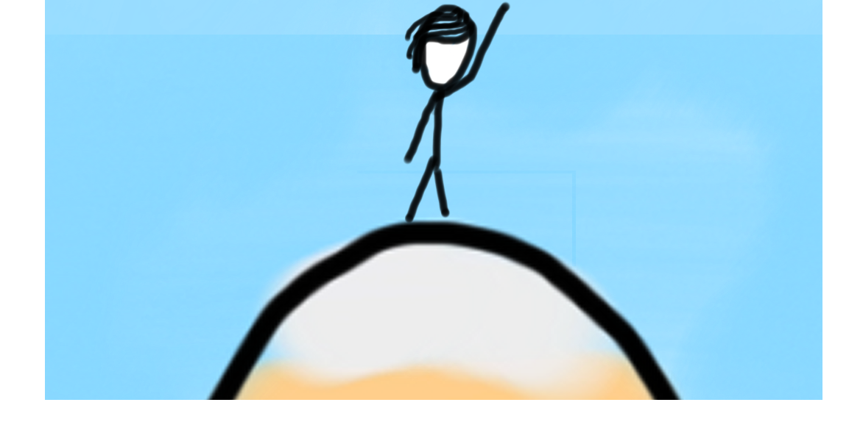

Today’s Goal
How do you make a box?
How do you see what is in a box?
What can you put in a box?
How do you change what is in a box?

Slide 14
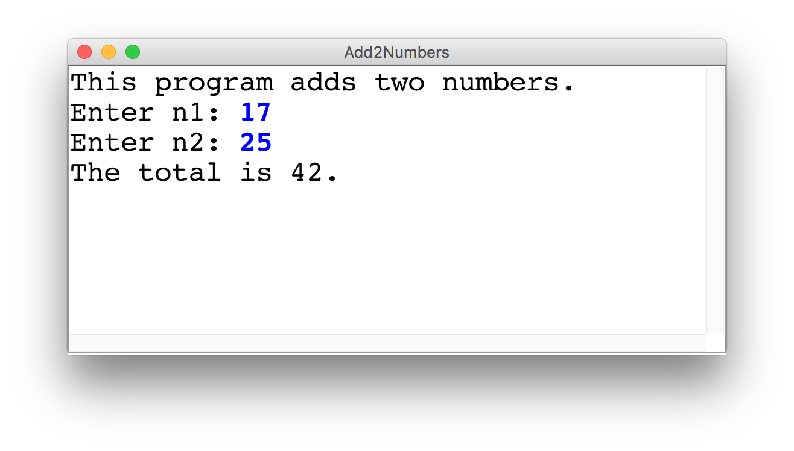
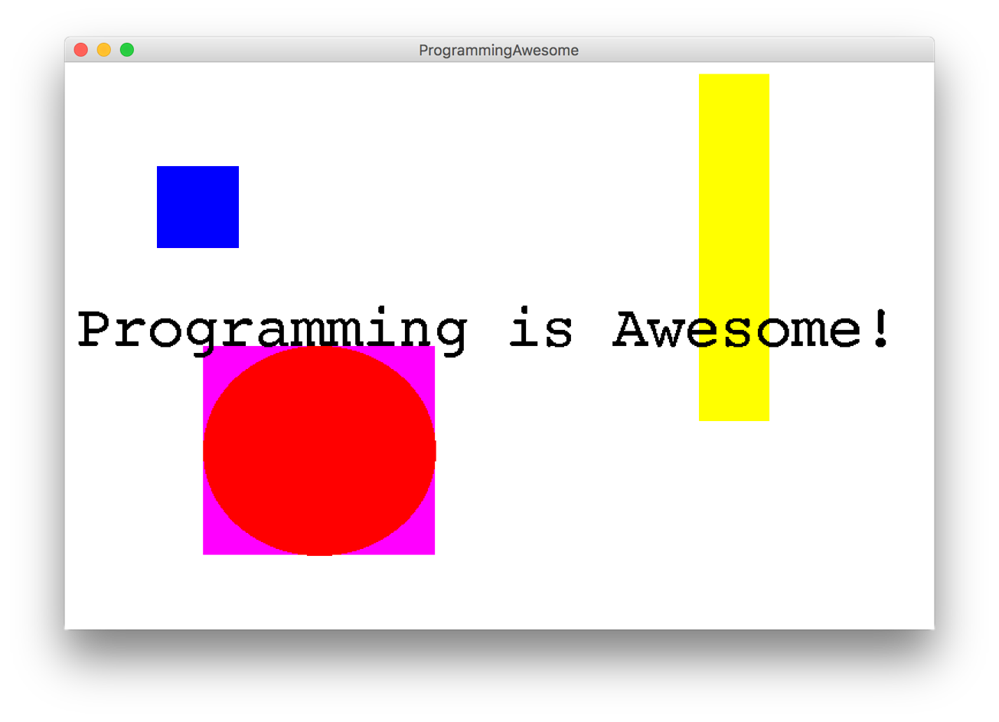
Two Example Programs

Slide 15
Types of Programs
Program
Console Program
Graphics Program
Karel Program

Slide 16

First Console Program: Hello World
import acm.program.*;
public class HelloProgram extends ConsoleProgram {
public void run() {
println("hello, world");
}
}
HelloConsole
hello, world

Slide 17
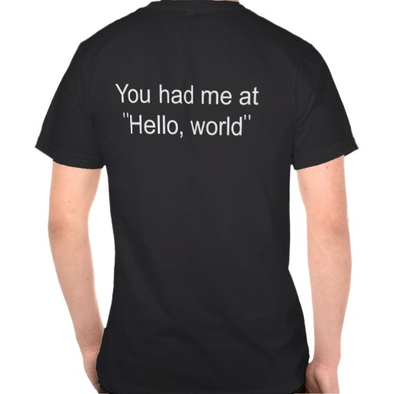

In Pop Culture

Slide 18
Add2Integers
class Add2Integers extends ConsoleProgram {
public void run() {
println("This program adds two numbers.");
int n1 = readInt("Enter n1: ");
int n2 = readInt("Enter n2: ");
int total = n1 + n2;
println("The total is " + total + ".");
}
}
n1
n1
n2
n2
total
total
17
17
25
25
42
42
Add2Integers
This program adds two numbers.
Enter n1:
17
Enter n2:
25
The total is 42.

Slide 19

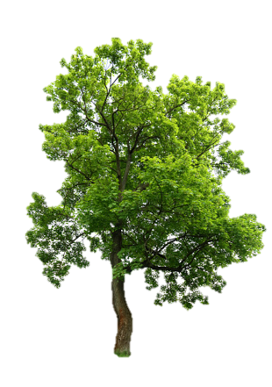
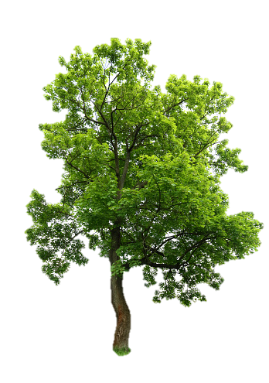
Today’s Route
You are here
Examples
Modify
Assign
Access
Variables
The River of Variables

Slide 20
Programs are control flow and variables

Slide 21
What is a variable?

Slide 22
[suspense]

Slide 23
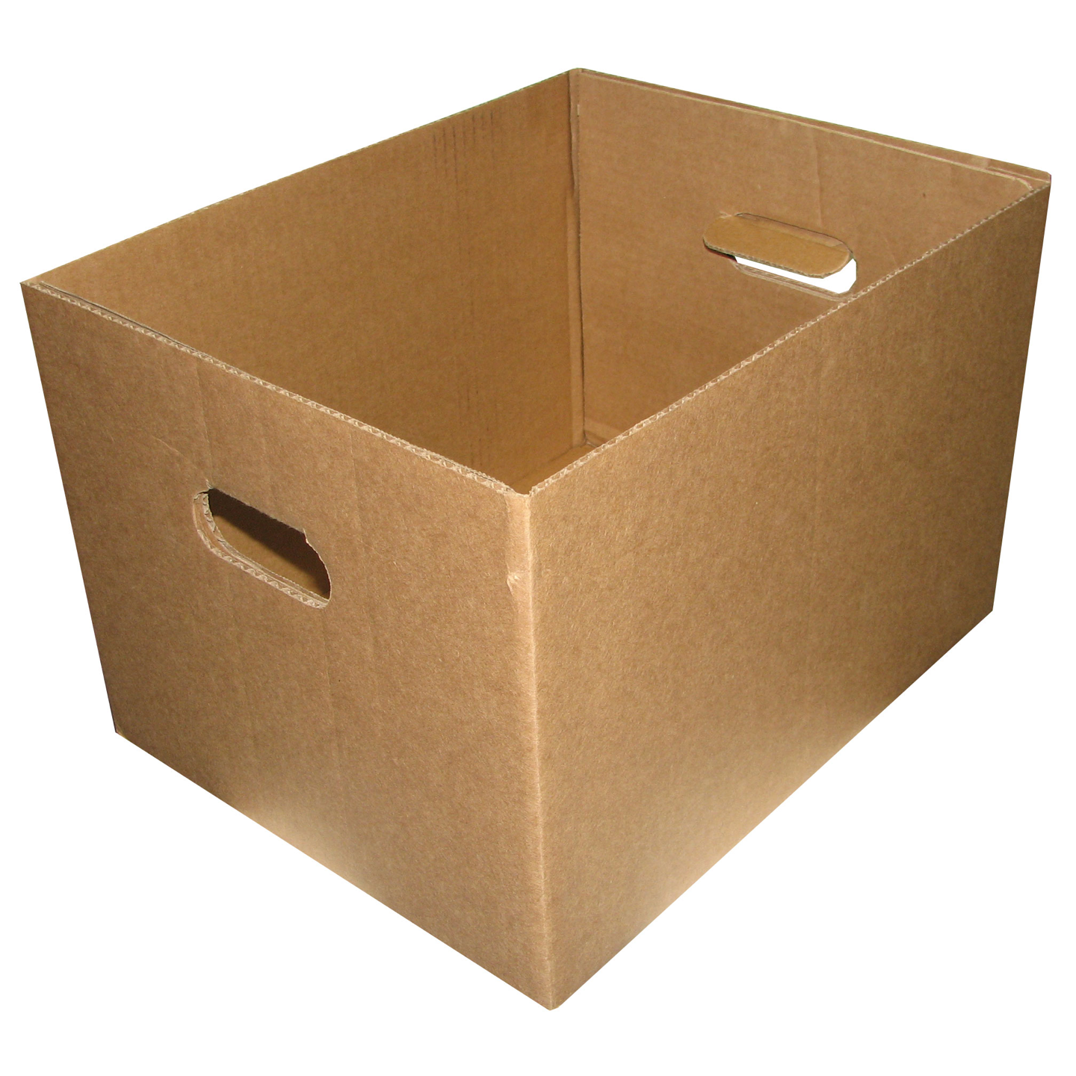
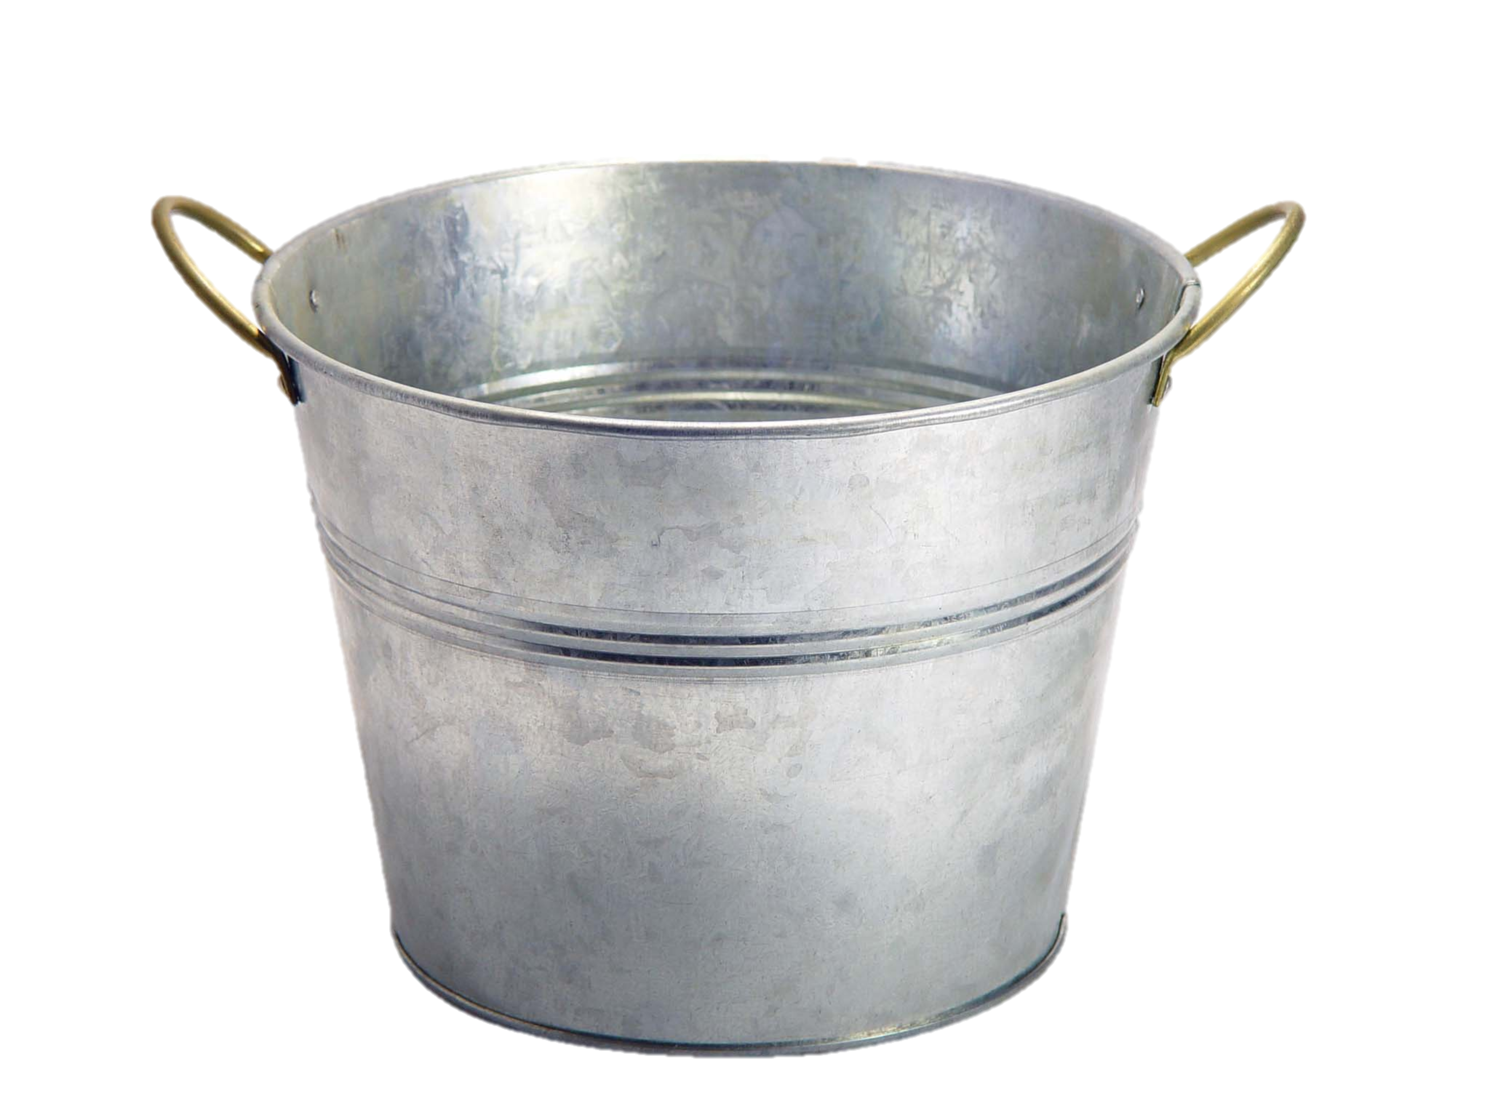
Variables are Like Boxes

Slide 24

Teeny Tiny Boxes
My computer has space for about 2 billion boxes

Slide 25
Making a New Variable
int age = 29;

Slide 26
Making a New Variable
type
name
int age = 29;
Initial value

Slide 27
Three Properties
name
type
age
29
(contains an int)
value
Notes:
Type name = value

Slide 28

Resulting Type of Binary Expression
When a line starts with a variable type, it is creating a new variable …aka a box.
Example:
int myBox = 5;

Slide 29
Core Types
// integer values
int num = 5;
// real values
double fraction = 0.2;
// true or false
boolean isLove = true;
* Why is it called a double?

Slide 30
Core Types
// letters
char letter = ‘c’;
// “strings” of letters
String phrase = “Spring rocks!”;

Slide 31
Core Types
// integer values
int num = 5;
// real values
double fraction = 0.2;
// true or false
boolean isLove = true;
* Why is it called a double?

Slide 32
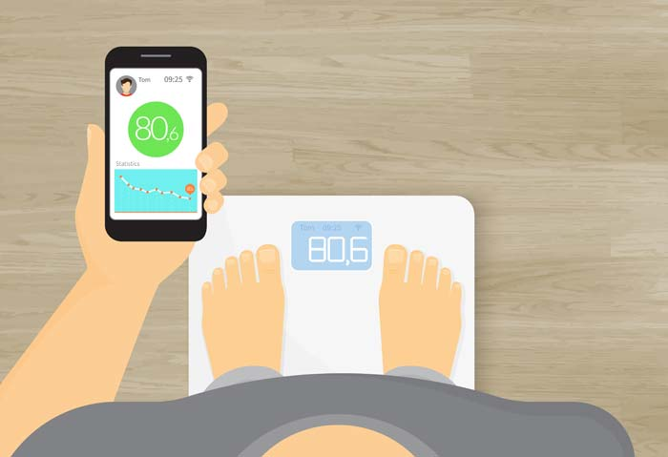
Double: How Much Do I Weigh?
* Answers could be real valued numbers

Slide 33
Int: How Many Children Do I Have?
* It is weird to say something like 1.7

Slide 34
Lots of Boxes
public void run() {
// integer values
int age = 29;
// real values
double weight = 180.2;
}

Slide 35
Can you access the value in a variable
(aka box)?

Slide 36
Outputting Variable Value
// creates a variable called
// age with the value 29.
int age = 29;
// puts the value of the age
// variable on the screen.
println(age);
* Fun fact. Chris turns 30 on April 25th

Slide 37
Fancy Output
// creates a variable called
// age with the value 29.
int age = 29;
// puts the following on the
// screen
// age is: <value>
println(“age is: “ + age);
* Fun fact. Chris turns 30 on April 25th

Slide 38
What data can you put in a variable
(aka box)?

Slide 39
Add2Integers
class Add2Integers extends ConsoleProgram {
public void run() {
println("This program adds two numbers.");
int n1 = readInt("Enter n1: ");
int n2 = readInt("Enter n2: ");
int total = n1 + n2;
println("The total is " + total + ".");
}
}
n1
n1
n2
n2
total
total
17
17
25
25
42
42
Add2Integers
This program adds two numbers.
Enter n1:
17
Enter n2:
25
The total is 42.

Slide 40
Making a New Variable
type
name
int myBox = user input;
Initial value

Slide 41
Making a New Variable
type
name
int myBox = expression;
Initial value

Slide 42
Values from User Input
// Prompts user for a whole number. Stores
// result in a variable (aka a box)
int kids = readInt(“How many children?”);
// Prompts user for a decimal number. Stores
// result in a variable (aka a box)
double tip = readDouble(“Tip? $”);
// Haven’t you ever wondered, who was the first
// person to eat a carrot???
boolean edible = readBoolean(“Subject alive?”)

Slide 43
Add2Integers
class Add2Integers extends ConsoleProgram {
public void run() {
println("This program adds two numbers.");
int n1 = readInt("Enter n1: ");
int n2 = readInt("Enter n2: ");
int total = n1 + n2;
println("The total is " + total + ".");
}
}
n1
n1
n2
n2
total
total
17
17
25
25
42
42
Add2Integers
This program adds two numbers.
Enter n1:
17
Enter n2:
25
The total is 42.

Slide 44
Binary Operators
+
Addition
*
Multiplication
–
Subtraction
/
Division
%
Remainder
See you another day, tio.

Slide 45
Learn by examples

Slide 46
Order of Operation
// Mult before addition first!
int result = 4 + 2 * 3;
// 10
// Left to right!
int sum = 1 + 2 + (3 * 4);
// 15
Priority | Operator | Tie breaker
Highest | () | Left to right
Middle | * / | Left to right
Lowest | + - | Left to right

Slide 47
What do you think this does?
// creates a variable called
// success rate
double successRate = 1 / 2;

Slide 48
AHHHHHHH!!!!!!
// creates a variable called
// success rate
double successRate = 1 / 2;
0.0

Slide 49
Resulting Type of Binary Expression
All binary operators result in a value (like a temporary variable) which has a type. You need to know what type that will be.
Most important example:
int / int results in an int

Slide 50
AHHHHHHH!!!!!!
// creates a variable called
// success rate
double successRate = 1 / 2;
int
int

Slide 51
Resulting Type
int / int results in an int
double * double results in a double
int + double results in a double

Slide 52
Resulting Type of Binary Expression
All binary operators result in a value (like a temporary variable) which has a type. The general rule is: operations always return the most expressive type:
Expressive hierarchy:
boolean < char < int < double < String
Example:
int / double results in a double

Slide 53
Even more examples…

Slide 54

Pitfalls of Integer Division
Convert 100˚ Celsius temperature to its Fahrenheit equivalent:
double c = 100;
double f = 9 / 5 * c + 32;
The computation consists of evaluating the following expression:
9 / 5 * c + 32
The problem arises from the fact that both 9 and 5 are of type int, which means that the result is also an int.
132
100
1
9 / 5 * c + 32
Notes:
Correct answer should be 212

Slide 55
Pitfalls of Integer Division
You can fix this problem by converting the fraction to a double, either by inserting decimal points or by using a type cast:
double c = 100;
double f = 9.0 / 5 * c + 32;
The computation now looks like this:
212.0
180.0
1.8
9.0
/ 5 * c + 32

Slide 56
Practice
5 + 3 / 2 - 4
15 / 2.0 + 6
// 2
// 13.5
Notes:
2
13.5
11
abc12
abc3

Slide 57
Can you change the value in a variable
(aka box)?

Slide 58
Modifying a Variable
// creates a variable called
// age with the value 29.
int age = 29;
// this puts a new value in the box
age = 30;
// In what world does this make sense?
// Welcome to Java
age = age + 2;

Slide 59
Compiler Errors
A variable can't be used until it is assigned a value.
int x;
println(x); // Error: x has no value
You may not declare the same variable twice.
int y = 3;
int y = 5; // Error: y already exists
You may not use a variable until it is declared.
z = 10; // Error: z cannot be resolved
Notes:
How can we fix this?

Slide 60
Today’s Route
You are here
Examples
Modify
Assign
Access
Variables
The River of Variables

Slide 61
Today’s Route
You are here
Examples
Modify
Assign
Access
Variables
The River of Variables

Slide 62
Today’s Goal
How do you make a box?
How do you see what is in a box?
What can you put in a box?
How do you change what is in a box?

Slide 63
Practice 1: Receipt Program
Let’s write a ConsoleProgram that calculates the tax, tip and total bill for us at a restaurant.
The program should ask the user for the subtotal, and then calculate and print out the tax, tip and total.

Slide 64
If there is time “Remaining”
%

